Slide 1



Smart Consuming Automation
Jarrod hattING – THIBAUD DE TREGLODE - Ryckiel hossie

Slide 2
The problem

Slide 3
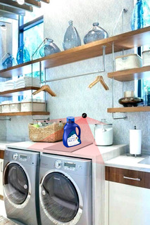
The product
How does it work?
Hardware equiped
Back-up by an app for additional info
Can be positioned anywhere

Slide 4
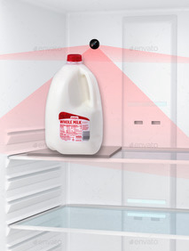
The product
What are the benefits?
Next steps
Automate ordering process
Increase productivity
Avoid waste & back-up purchase
Develop prototype
Market research
Additional features

Slide 5
Revenue Stream options
Option 1
Option 2
Option 3
Price
Between $200-$300
$100
$50
Subscription
No monthly fees
Monthly subscription with add-ons on an app
Monthly subscription with add-ons on an app
Commission
No commission
1%-2% fee on every purchase
No Commission
Data Management
Data are kept private
Data are kept private
Data are sold

Slide 6
Thank you!

Slide 7
Quick Survey
1
How many of you think that this would be beneficial to you?
2
How many of you are worried about sharing your data?
3
Would you be ok with receiving life-time discount in exchange for your data?

